Slide 1
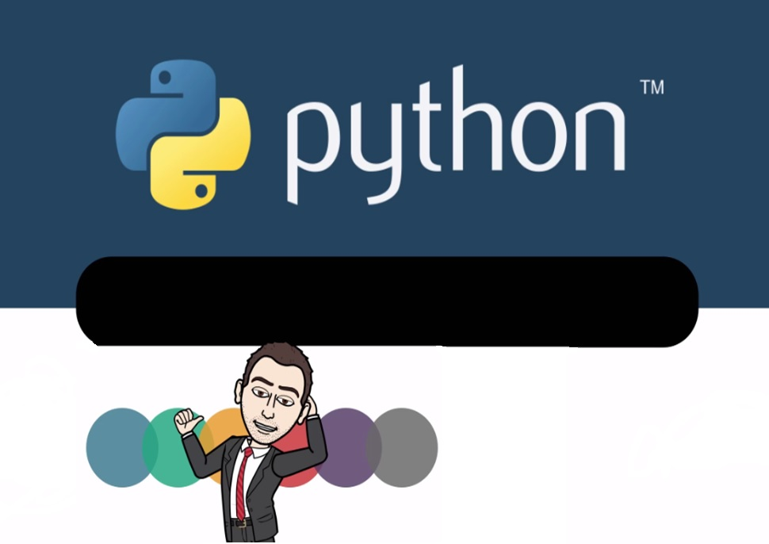
Date: 04/07/2018
Introduction
Presented by -
Chetan Mahajan
Assistant Professor
Information Technology Department,
Shah & Anchor Kutchhi Engineering College, Chembur

Slide 2
Agenda
Functions in Python
Classes and Objects
Modules and Packages

Slide 3
Why We Learn Programming Languages?
Programming languages help to do automate repetitive tasks.
Software eliminate human error and increase productivity, provided the software user, knows the underlying theory.
That's why programming devices Calculator, A.C., Washing Machine, Refrigerator etc. and software such as AutoCAD, MatLab, PrimaVera etc. are we commonly used.

Slide 4
How to choose a Programming Languages?
Easy to learn.
If learn this language then where to use?
Popularity

Slide 5
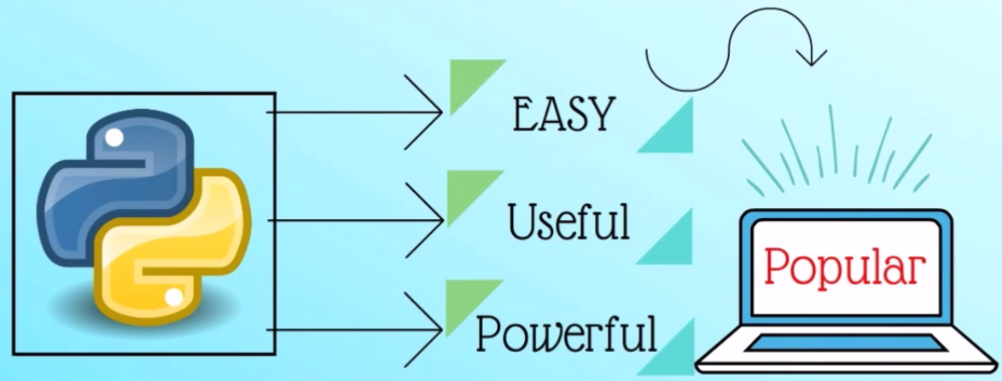
Python (Open Source language)
Have a lot of applications in various field
Web development- excellent web framework including Pyramid, Django and Flask
To Writing Scripts-easy to write scripts using python
GUI development- using Tkinter, PyQt module
Game Development- Create video game using Pygame module
Browser Automation- used by Facebook, Google, Instagram
Data Analysis- using Nmpy, Matplotlib
Machine learning- wonderful libraries such as Scikits-Learn, NLTK and TensorFlow

Slide 6
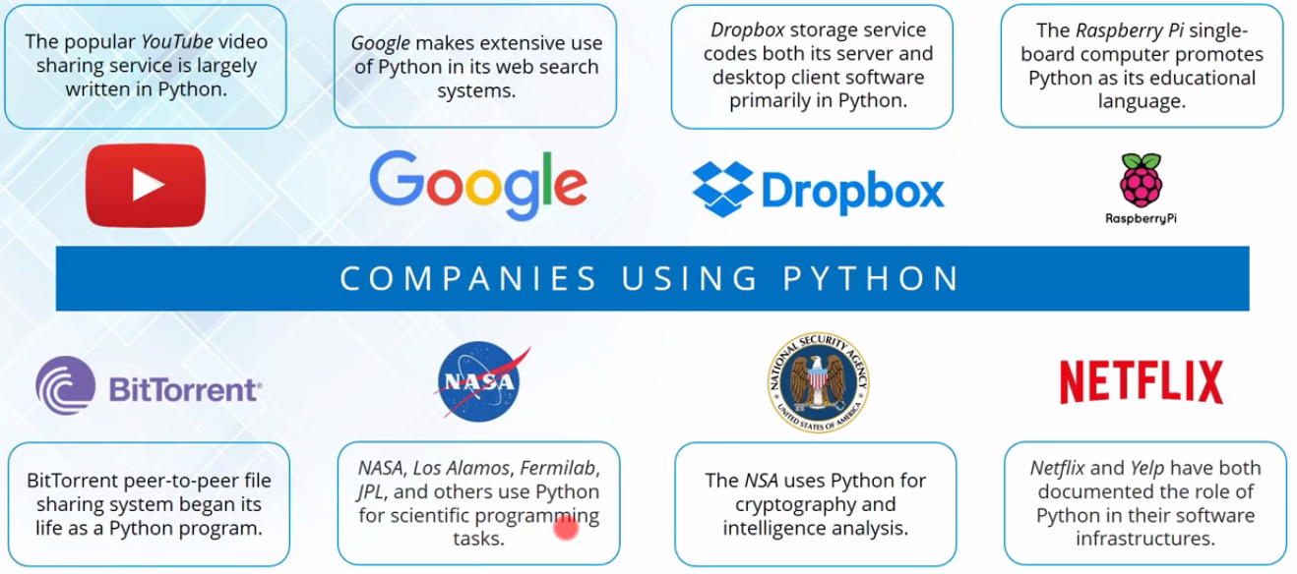
Who uses Python
Ref: by Eureka.com

Slide 7
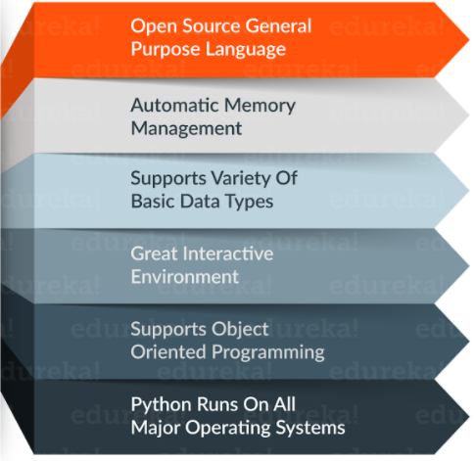
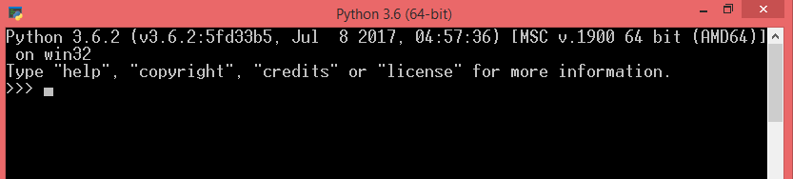
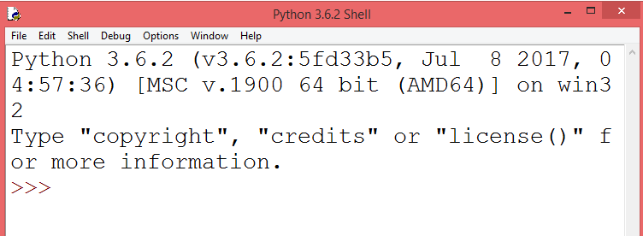
Python (Open Source language)
Created in 1989 by Guido Van Rossum (Dutch)
Python is an interpreted, object oriented, high-level programming language with dynamic semantics.
Currently two major version available 3.x and 2.x
Python Console
An “Interactive Shell” where you enter code.
You type code, it responds immediately.
>>> is prompt for the next command.
Python IDLE
Integrated DeveLopment Enviroment (IDLE)
Used to create, save and run simple programs (.py files)

Slide 8
Variable & Data Type in Python
A variable is named place in the memory where a programmer can store data and later retrieve the data using the variable ‘name’.
When you create a variable you reserve some space in memory.
You can change the content of a variable in a later statement.
Variable Name:
Can contain letters, numbers, and underscores
Must begin with a letter
Cannot be one of the reserved Python keywords: and, as, assert, break, class, continue, def, del, elif, else, except, exec, finally, for, from, global, if, import, in, is, lambda, not, or, pass, print, raise, return, try, while, with, yield
A data type, in programming, is a classification that specifies which type of value a variable has and what type of mathematical, relational or logical operations can be applied to it without causing an error.

Slide 9
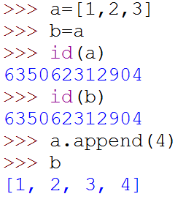
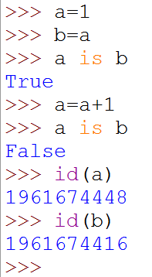
Variable in Python
No need to declare
Need to assign (initialize)
use of uninitialized variable raises exception
Not typed
a= 2
a=2.5
a=‘sakec’
Actually, in Python “variables” are really object references. The reason we don't need to declare types is that a reference might point to a different type later.
Assignment manipulates references
x = y does not make a copy of y
x = y makes x reference the object y references
Very useful; but beware!
Example:
a = [1, 2, 3]
a
1
2
3
a
1
2
3
b = a
b
a
1
2
3
4
a.append(4)
b
a = 1
a
1
a
b = a
1
new int object created
by add operator (1+1)
b
a
2
a = a+1
1
old reference deleted
by assignment (a=...)
b

Slide 10
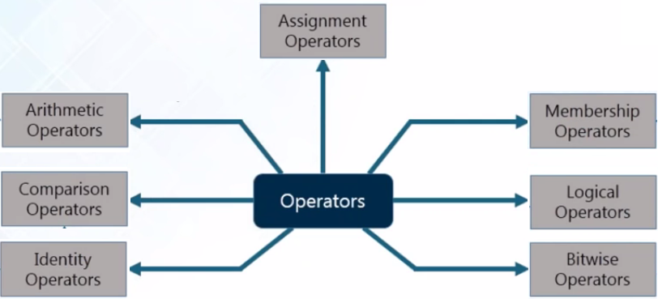
Operator in Python

Slide 11
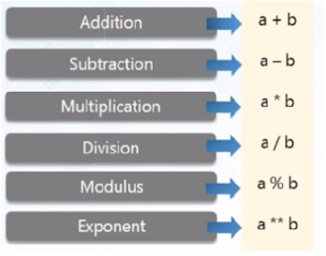
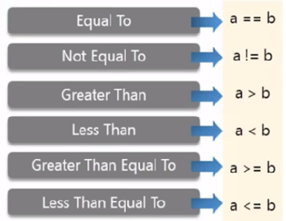
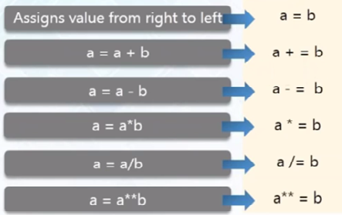
Operator in Python
Arithmetic
Comparison
Assignment
Note:
give True False output
Note:
Python support += , but ++ (or --) do not work in Python

Slide 12
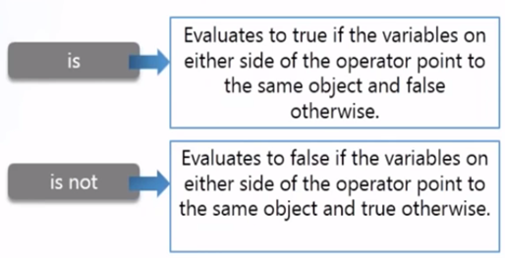
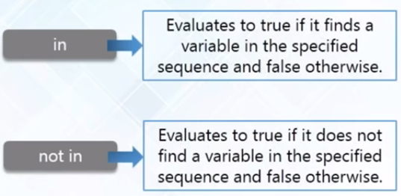
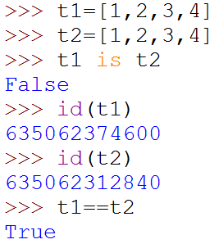
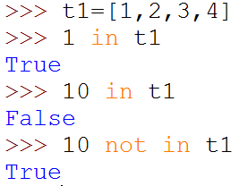
Operator in Python
Identity
Membership

Slide 13
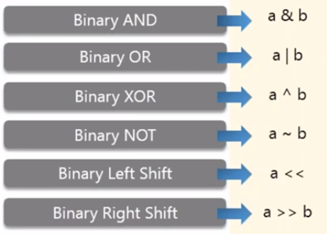
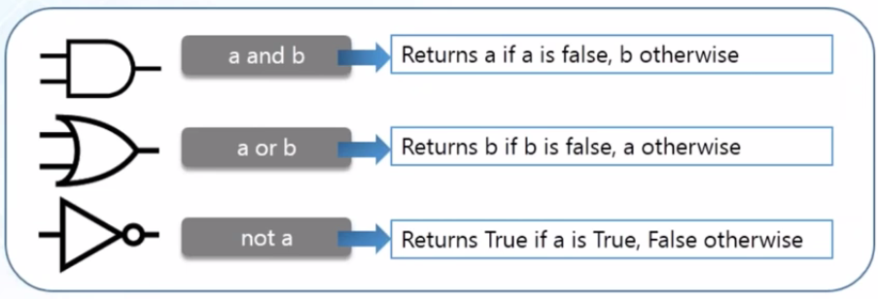
Operator in Python
Bitwise
Logical

Slide 14
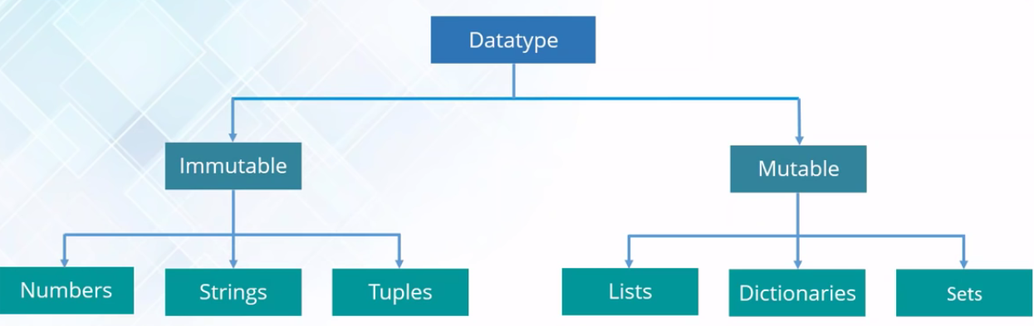
Data Type
Python is a loosely typed language, therefore no need to define the datatype of variable.
No need to declare before using them.
Python have two type Data type: Immutable (not change value), Mutable (change value possible)

Slide 15
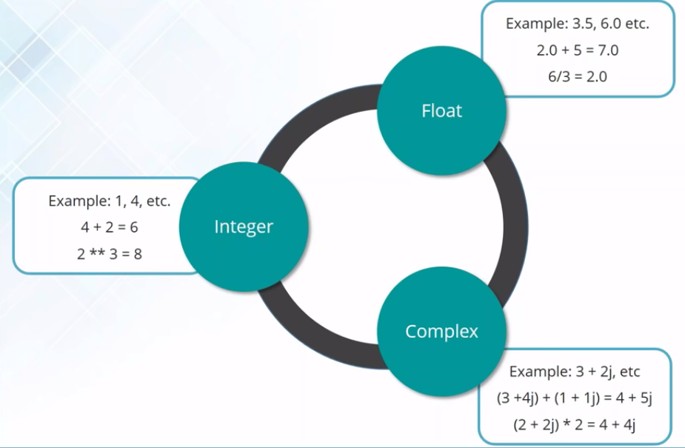
Data Type: Numeric
Just as expected Numeric data types store numeric values.
They are immutable data types, this means that, you cannot change it’s value.
Python supports three different Numeric data types: Integer, Float, Complex

Slide 16
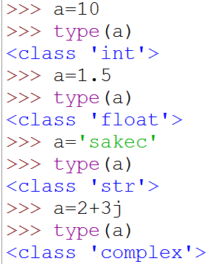
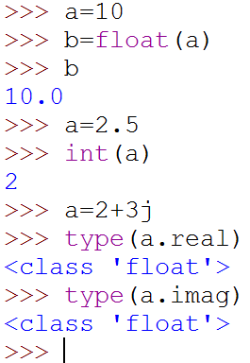
Numeric Data Type: Practice
Assignment value to variable
Checking data type of variable
Type conversion
Finding real / Imaginary part of complex number

Slide 17
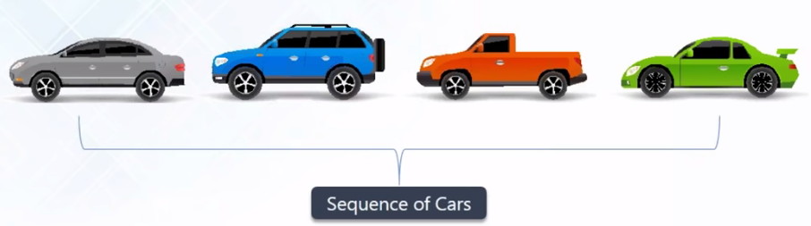
Python Sequences
Sequences are containers with items that are accessible by indexing or slicing
Operations on Sequences
Python Function supported by Sequences
len(object)
max(object)
min(object)
list(object), tuple(object), set(object), etc..

Slide 18
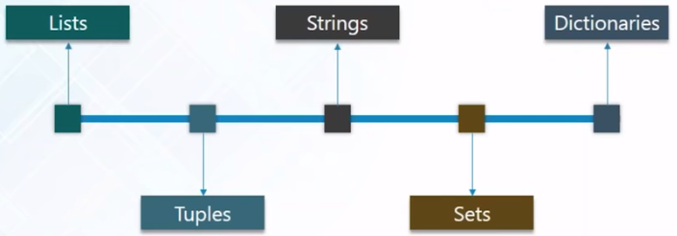
Python Sequences

Slide 19
Data Type: String
Strings are sequences of one character strings.
We can create strings by enclosing characters in quotes. Python treats single quotes the same as double quotes.
Example: str = “Welcome to Python World”
Or
str = ‘Welcome to Python World’
Multi-line strings can be denoted using triple quotes.
Example: str = ‘’’Welcome to Python World’’’
String are immutable, so we cant change value of string.
Value accessed by index value using [] bracket.
String have two type indexing positive and negative
String positive index start from left side value 0 and negative index start from right with index -1

Slide 20
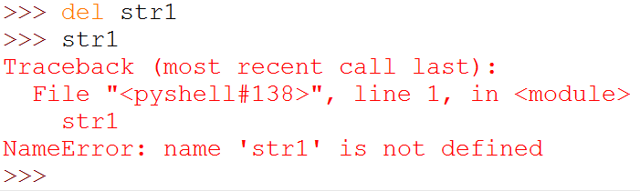
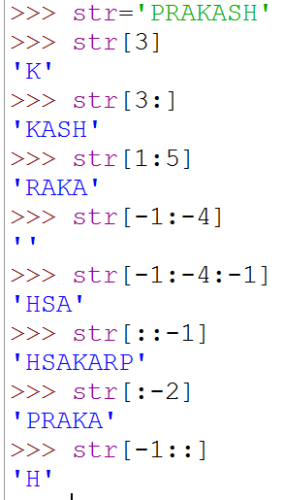
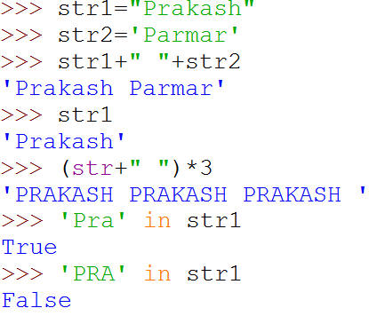
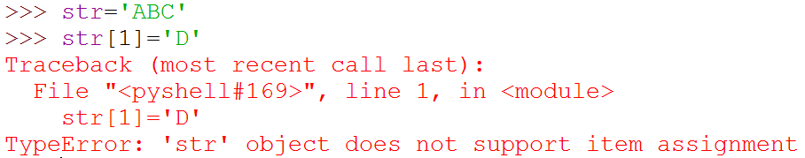
String Operations
Accessing & Slicing operation
Repetition & Concatenation operation

Slide 21
Built-in String Methods
In Python, a method is a function that is defined with respect to a particular object.
Syntax: object.method(arguments)
Methods | Description | Syntax
lower() | return the new copy of the string with all lowercase letter. | str.lower()
upper() | return the new copy of the string with all uppercase letter. | str.upper()
lstrip() | return the new copy of the string with all left whitespace / given character removed. | str.lstrip(‘character to remove’)
rstrip() | return the new copy of the string with all right whitespace / given character removed. | str.lstrip(‘character to remove’)
strip() | return the new copy of the string with all right and left whitespace removed | str.lstrip(‘character to remove’)
isalpha() | return true if string contains only character otherwise return false. empty string gives false. | str.isalpha()
isdigit() | return true if string contains only digit otherwise return false. empty string gives false. | str.isdigit()
replace() | return the new copy of the string with all the occurrences of substring replaced by new substring. | str.repalce(old_substring, new_substring, max_occurrences-1)
find() | return the index of string if occurs in the defined range otherwise return -1 if not found. | str.find(find_substring, beg_index, end_index)
split() | return list of all the words in the string using given separator. | str.split(‘separator’, max_separator)

Slide 22
String Exercise
str=“chetan.mahajan@sakec.ac.in”
Find host name from sting.

Slide 23
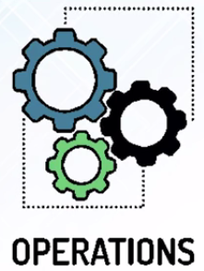
Data Type: List
A list is an ordered sequence of python object like number, string etc.
Example:
list=[10, 20, ‘abc’, [1,2]]

Slide 24
Built-in List Methods
Methods | Description | Syntax
append() | add object at end of list | lst. append(obj)
insert() | inserts object at given index, by default inserted at end | lst.insert(index,obj)
extend() | add object of a list to another list | lst.extend(list2)
pop() | removes object from end position, or from given index | lst.pop(), lst.pop(index)
remove() | remove given object form list | lst.remove(obj)
reverse() | reverse the object of list. | lst.reverse()
sort() | sort the items in the list, by default ascending for descending write reverse=true | lst.sort(), lst.sort(reverse=Ture)

Slide 25
Data Type: Tuple
A tuple is a sequence of python object. Tuples are sequences, just like Lists.
The differences between tuples and lists are, the tuples cannot be changed unlike lists and tuples use parentheses, whereas lists use square brackets.
Example:
tup=(10, 20, ‘abc’, [1,2])
Tuples are faster than lists.
all Tuple operations are similar to Lists, but you cannot update, delete or add an element to a Tuple.
Tuple are immutable, so we cant change value of tuple.

Slide 26
Data Type: Set
A set is an unordered collection of unique and immutable objects.
Every element is unique (no duplicates) and must be immutable (which cannot be changed)
Example: myset = {10, 20, ‘a’}
You can't add a list to a set, however you can add tuples to the set.
Since items in set are unordered so we cannot access or change an element of set using indexing or slicing.
Common uses include membership testing, removing duplicates from a sequence, and computing standard math operations on sets such as intersection, union, difference, and symmetric difference.

Slide 27
Data Type: Dictionary
A dictionary is an unordered collection of key-value pair.
Values any type but keys are immutable, means keys can be numbers, string or tuple. But it does not permit mutable objects like lists.
No duplicate key allowed. If duplicate keys encountered during assignment, the last assignment is taken.
Example:
dict = {1:10,2:'a','b':3,'c':'d',4:[1,2],'b':{20:40},(1,2):'c'}
Value can be accessed by key using [] bracket.

Slide 28
Input / Output, Comment function in Python
Output function:
print()
Input function:
variable_to_stored_value = input(“message for user”)
# symble used for Single line comment
For multi line comment we use quotes
''' This is a multi line comment
spanning more than one line
or more lines…. '''

Slide 29
Input / Output function in Python
Problem-1
Write a python program to find average of user defined three number.
Problem-2
Write a menu driven program to perform addition, subtraction, multiplication, division.

Slide 30
Input / Output function in Python
A-01: Write a python program to find average of user defined three number.
a = int(input("Enter first number : "))
b = int(input("Enter 2nd number : "))
c = int(input("Enter 3rd number : "))
print("Avg= ",(a+b+c)/3)
print("End of program! Thank you")

Slide 31
Input / Output function in Python
A-01: Write a menu driven program to perform addition, subtraction, multiplication, division
Solution:
choice = 0
a = int(input("Enter first number : "))
b = int(input("Enter 2nd number : "))
while choice !=5 :
print("Menu")
print("1. Addition")
print("2. Subtraction")
print("3. Multiplication")
print("4. Division")
print("5. Exit")
choice = int(input("Enter your choice : "))
if choice ==1 : print("Sum= ",a+b)
if choice ==2 : print("Sub= ",a-b)
if choice ==3 : print("Mul= ",a*b)
if choice ==4 : print("Div Quotient= ",a/b)
if choice ==5 : break
print("End of program! Thank you")

Slide 32
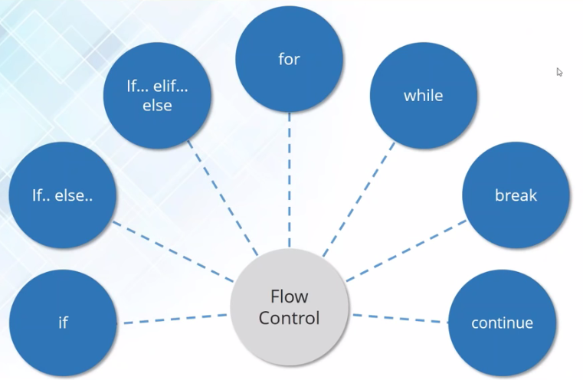
Flow Control in Python

Slide 33
Flow Control: Conditional Statements
Python uses three type of conditional statements
If
If-else
If-elif-else

Slide 34
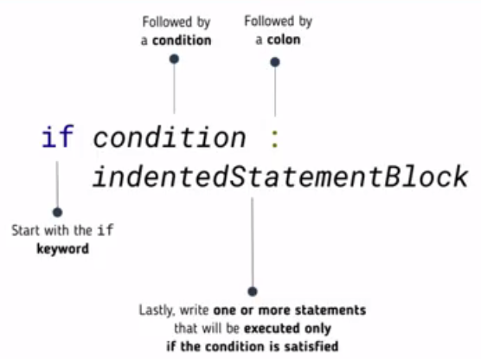
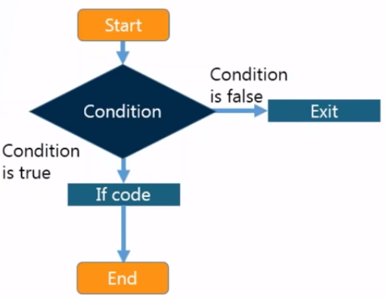
if Conditional Statements
Indententation is used to identify the scope of control blocks

Slide 35
if Conditional Statements
Problem:1
Write python program to display result of student only if he pass. (pass if marks >40). Marks taken from user.
Problem:2
Write python program to check user given number is positive, we print an appropriate message “number is positive”

Slide 36
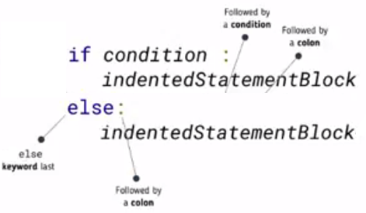
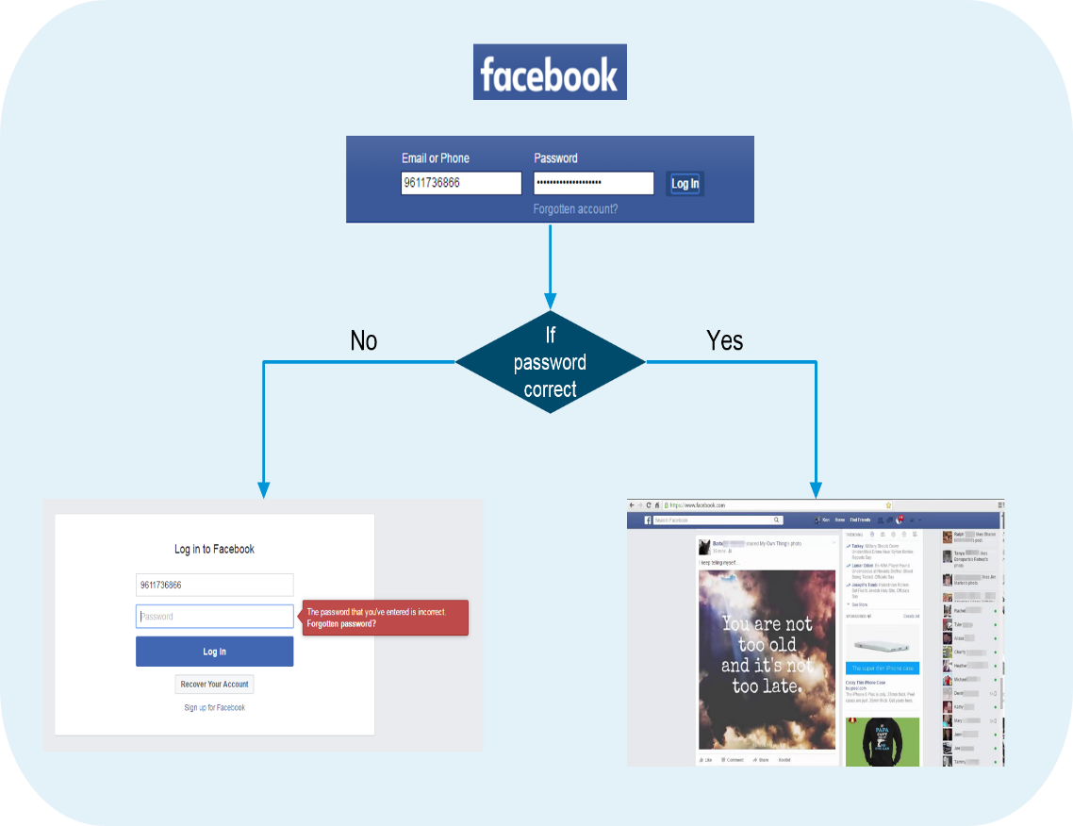
If-else Conditional Statements
Indententation is used to identify the scope of control blocks

Slide 37
If-else Conditional Statements
Problem:1
Write python program to display result of student. (pass if marks >40 otherwise fail). Marks taken from user.
Problem:2
Write python program to check user given number is positive or negative, we print an appropriate message “number is positive” or “number is negative”

Slide 38
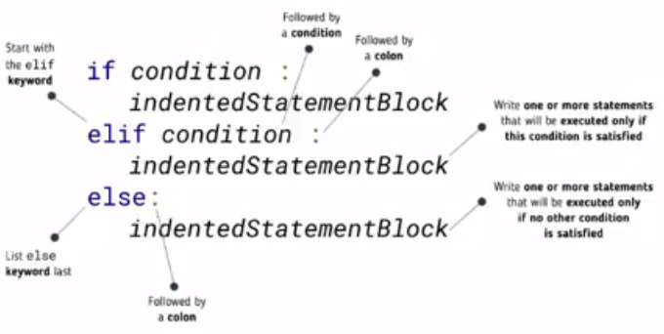
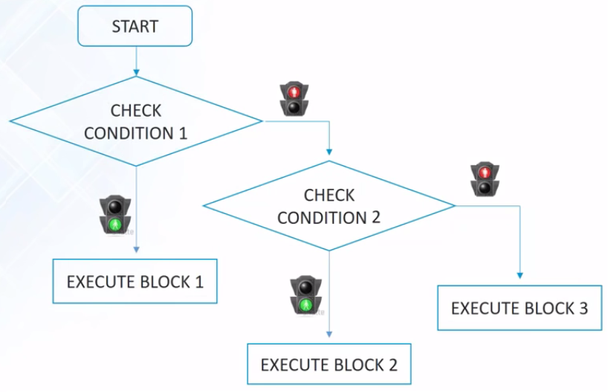
If-elif-else Conditional Statements
Indententation is used to identify the scope of control blocks
Python does not support switch statement, it is implemented by if-elif-else statements

Slide 39
Conditional Statements Practice
Problem:1
Write python program to display grade of student for user given marks.
Marks >=80 grade “A” , Marks >= 60 grade “B” , Marks >=40 grade “C” , Otherwise failed grade “F”
Problem:2
Write a Python program to get a string made of the first 2 and the last 2 chars from a given a string. If the string length is less than 2, return empty string.
Problem:3
Write a Python program to add ‘ing’ at the end of a given string (length should be at least 3). If the given string is already ends with ‘ing’ then add ‘ly’ instead. If the string length of the given string is less than 3, leave it unchanged.

Slide 40
Conditional Statements Practice
A-02:
Write a Python program to get a string made of the first 2 and the last 2 chars from a given a string. If the string length is less than 2, return empty string
Solution:
str=input("Enter a string")
if len(str)<2 :
print("None")
else :
print("String made from last two char of both ends is ", str[0:2]+str1[-2:])

Slide 41
Conditional Statements Practice
A-03:
Write a Python program to add ‘ing’ at the end of a given string (length should be at least 3). If the given string is already ends with ‘ing’ then add ‘ly’ instead. If the string length of the given string is less than 3, leave it unchanged
Solution:
str=input("Enter a string")
if len(str)>2 :
if str[-3:] == 'ing' :
str+='ly'
else:
str+='ing'
print("New String is ", str)

Slide 42
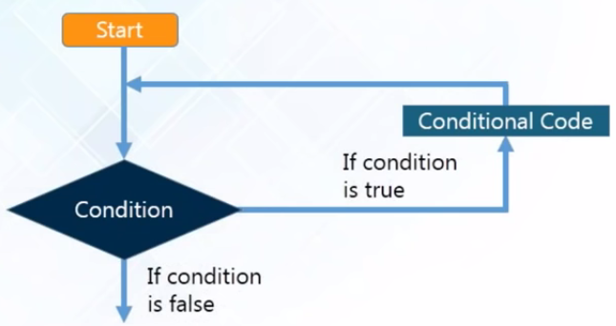
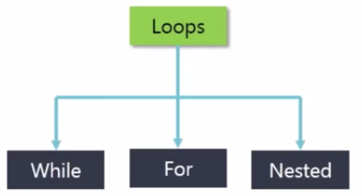
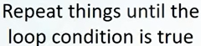
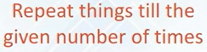
Iterative Statements (Loop) in Python
A iterative statements statement allow us to execute a statement or group of statements multiple times.
Similar to other languages Python uses ‘for’ and ‘while’ statements for iteration.
Iterative statements can be controlled using break and continue statements.

Slide 43
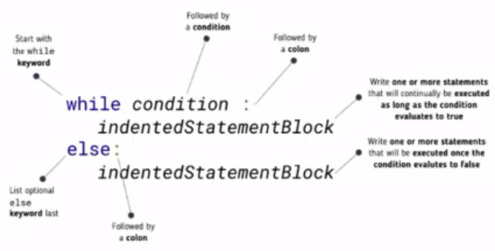
While Loop in Python
Repeats a statements or group of statements while a given condition is TRUE. It tests the condition before executing the loop body.
Indententation is used to identify the scope of control blocks

Slide 44
While Loop in Python
Write a Python program to get the LCM (least common multiple) of two positive numbers.
Ex. LCM(6, 10) is 30

Slide 45
While Loop in Python
A-02: Write a Python program to get the LCM (least common multiple) of two positive numbers
Solution:
a = int(input("Enter first number : "))
b = int(input("Enter 2nd number : "))
if a > b :
c = a
else:
c = b
while (True) :
if(c%a == 0) and (c%b == 0):
lcm = c
break
c+=1
print("LCM of ",a, " and ",b," is ", lcm)

Slide 46
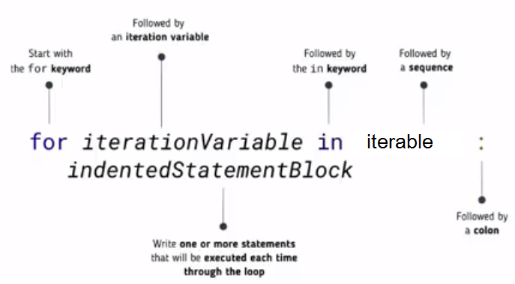
For Loop in Python
A for statements is an iterative control flow statement that execute code for every item in iterable or sequence.
Used to execute code a fixed numbers of times using the built in range() function.
Iterable produces a stream of values
Each values assign to iteration variable
Execute indented statement for each values

Slide 47
For Loop in Python
Lots of different things are iterable
Iterate a list
for e in [1, 2, 3, 4] :
print (e)
output:
1
2
3
4
Iterate a string
for c in “Python” :
print (c)
output:
P
y
t
h
o
n
Note:
Iterate each element of list
Note:
Iterate each character of string

Slide 48
For Loop in Python
Iterate a range
for i in range(5) :
print (i)
output:
0
1
2
3
4
Iterate a dict
for d in {“A”:1, “B”:2, “C”:3} :
print (d)
output:
A
B
C

Slide 49
For Loop in Python
What is output of following code ?
for i in range(10) :
print (i)
for i in range(5, 12) :
print (i)
for i in range(10, 40, 5) :
print (i)
list = [2, 8, 9, 10, 11 ]
for i in range(1, 12) :
if i in list :
continue
print (i)
WAP to print even number from given list = [10, 20, 30, 45, 79, 88, 87]
WAP to print list element and their length
fruits = [‘banana’ , ‘mango’, ‘apple’, ‘orange’]
3. WAP to print list element upto apple
fruits = [‘banana’ , ‘mango’, ‘apple’, ‘orange’]

Slide 50
For Loop in Python
WAP to print even number from given list = [10, 20, 30, 45, 79, 88, 87]
WAP to print list element and their length
fruits = [‘banana’ , ‘mango’, ‘apple’, ‘orange’]
3. WAP to print list element upto apple
fruits = [‘banana’ , ‘mango’, ‘apple’, ‘orange’]

Slide 51
Function in Python
The programmer mantra “Write once, Use often”
Programmer follow a philosophy of reuse
For Reuseable code
To identify anything that you do over and over again.
Separate out commonly used chunks of code into reusable function
A function is nothing more than a block of commands organized together to perform an operation
You have already used many built-in-Python function such as
print(), input(), type(), help() etc.
Formal parameter
Definition of Function
def functionName(parameters) :
indentedStatementsBlock
return value
optional
Calling a Function
functionName(parameters)
Actual parameter

Slide 52
Function in Python
Position of Parameter
def avg(n1, n2, n3) :
print("n1= ",n1, "n2= ",n2, "n3= ",n3)
return (n1+n2+n3)/3.0
result=avg(n2=5, n3=1, n1=8)
print(result)
default Parameter
def avg(n1, n2, n3=5) :
#print("n1= ",n1, "n2= ",n2, "n3= ",n3)
return (n1+n2+n3)/3.0
print ( avg(10, 20) )
print ( avg(10,20,30) )

Slide 53
Function in Python
Variable length arugments
def funct1(*argument) :
for num in argument :
print(num)
funct1(10,20)
print("\n")
funct1(10,20,30)
print("\n")
funct1(10,20,30,40)
Anonymous function (Lambda function)
Function without name i.e. without def keyword
sum = lambda var1, var2: var1 + var2
print("sum is : ", sum(10,20))

Slide 54
Exercise 1:
Add a function named list_benefits() that returns the following list of strings: "More organized code", "More readable code", "Easier code reuse", "Allowing programmers to share and connect code together"
Add a function named build_sentence(info) which receives a single argument containing a string and returns a sentence starting with the given string and ending with the string " is a benefit of functions!"

Slide 55
Pass by Reference
All parameters (arguments) in the Python language are passed by reference. It means if you change what a parameter refers to within a function, the change also reflects back in the calling function.
def changeme( mylist ):
"This changes a passed list into this function"
print ("Values inside the function before change: ", mylist)
mylist[2]=50
print ("Values inside the function after change: ", mylist)
return
# Now you can call changeme function
mylist = [10,20,30]
changeme( mylist )
print ("Values outside the function: ", mylist)

Slide 56
Pass by Reference (overwritten)
def changeme( mylist ):
"This changes a passed list into this function"
mylist = [1,2,3,4] # This would assi new reference in mylist
print ("Values inside the function: ", mylist)
return
# Now you can call changeme function
mylist = [10,20,30]
changeme( mylist )
print ("Values outside the function: ", mylist)

Slide 57
Global vs. Local variables
All variables in a program may not be accessible at all locations in that program. This depends on where you have declared a variable.
Variables that are defined inside a function body have a local scope, and those defined outside have a global scope.
total = 0 # This is global variable.
# Function definition is here
def sum( arg1, arg2 ):
# Add both the parameters and return them."
total = arg1 + arg2; # Here total is local variable.
print ("Inside the function local total : ", total)
return total
# Now you can call sum function
sum( 10, 20 )
print ("Outside the function global total : ", total )

Slide 58
Overview of OOP Terminology
Class − A user-defined prototype for an object that defines a set of attributes that characterize any object of the class. The attributes are data members (class variables and instance variables) and methods, accessed via dot notation.
Object − A unique instance of a data structure that is defined by its class. An object comprises both data members (class variables and instance variables) and methods.
Class variable − A variable that is shared by all instances of a class. Class variables are defined within a class but outside any of the class's methods. Class variables are not used as frequently as instance variables are.
Data member − A class variable or instance variable that holds data associated with a class and its objects.
Function overloading − The assignment of more than one behavior to a particular function. The operation performed varies by the types of objects or arguments involved.
Operator overloading − The assignment of more than one function to a particular operator.
Inheritance − The transfer of the characteristics of a class to other classes that are derived from it.
Method − A special kind of function that is defined in a class definition.
Instance variable − A variable that is defined inside a method and belongs only to the current instance of a class.
Instance − An individual object of a certain class. An object obj that belongs to a class Circle, for example, is an instance of the class Circle.
Instantiation − The creation of an instance of a class.

Slide 59
Classes and Objects
The class statement creates a new class definition. The name of the class immediately follows the keyword class followed by a colon as follows −
class ClassName:
'Optional class documentation string'
class_suite

Slide 60
Basic Class Example
class MyClass:
variable = "blah"
def function(self):
print("This is a message inside the class.")
myobjectx = MyClass()
myobjectx.variable

Slide 61
Create Multiple Different Objects
class MyClass:
variable = "blah"
def function(self):
print("This is a message inside the class.")
myobjectx = MyClass()
myobjecty = MyClass()
myobjecty.variable = "yackity“
# Then print out both values
print(myobjectx.variable)
print(myobjecty.variable)

Slide 62
Accessing Object Functions
class MyClass:
variable = "blah"
def function(self):
print("This is a message inside the class.")
myobjectx = MyClass()
myobjectx.function()

Slide 63
Exercise
We have a class defined for vehicles. Create two new vehicles called car1 and car2. Set car1 to be a red convertible worth ₹ 60,00,000 with a name of Fer, and car2 to be a blue van named Jump worth ₹10,00,000

Slide 64
Constructor
class Employee:
'Common base class for all employees'
empCount = 0
def __init__(self, name, salary):
self.name = name
self.salary = salary
Employee.empCount += 1
def displayCount(self):
print ("Total Employee %d" % Employee.empCount)
def displayEmployee(self):
print ("Name : ", self.name, ", Salary: ", self.salary)

Slide 65
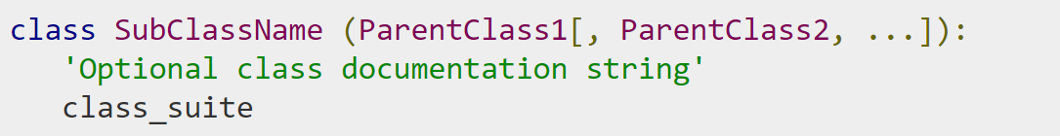
Class Inheritance
Syntax
Derived classes are declared much like their parent class; however, a list of base classes to inherit from is given after the class name −

Slide 66
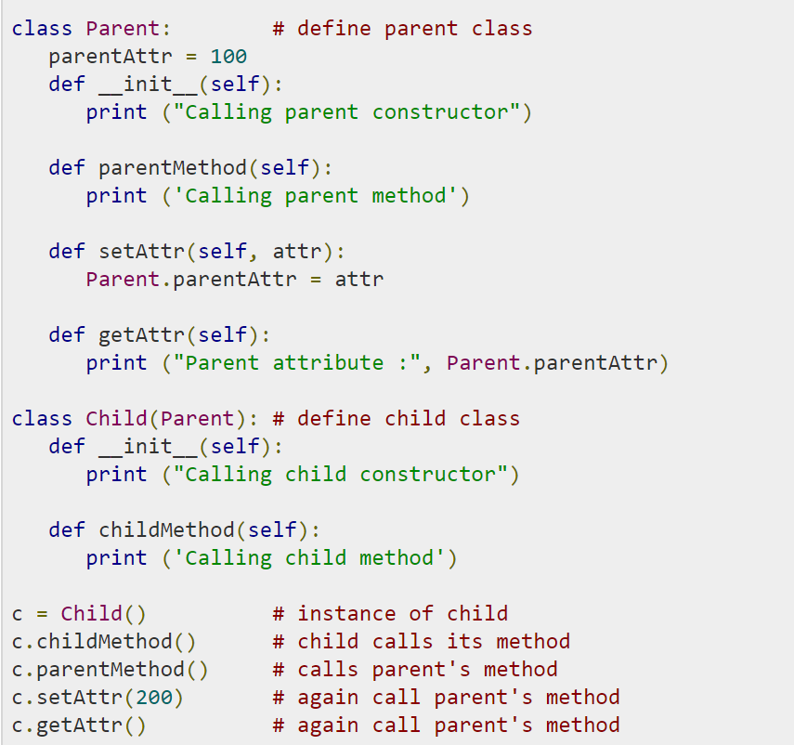
Class Inheritance

Slide 67
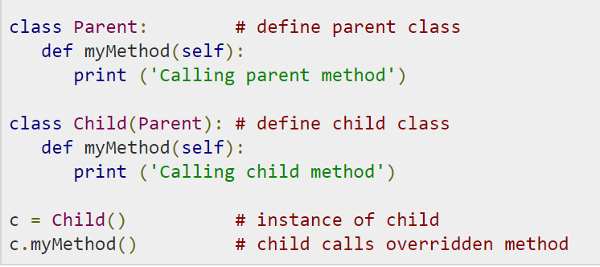
Overriding Methods

Slide 68
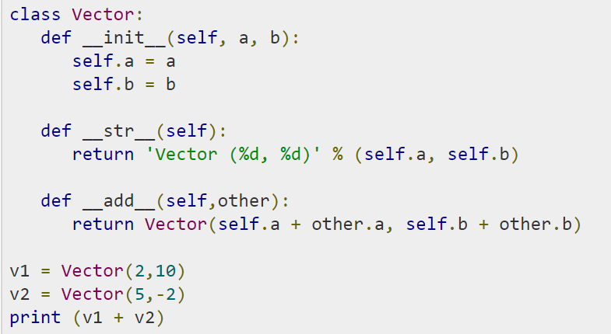
Overriding Operators

Slide 69
Modules
A module allows you to logically organize your Python code.
A module can define functions, classes and variables.
A module can also include runnable code.

Slide 70
Packages
A package is a hierarchical file directory structure that defines a single Python application environment that consists of modules and subpackages and sub-subpackages, and so on.

Slide 71
Thank you

